Slide 1
Export Tables from VINCI to a CSV file

Slide 2
Why bother
Yes, you can just right click on the table and click save as csv but…
This other method allows:
Batch Exporting
Offers more customizability (pick delimiters etc)
Better chance of retaining formatting
Set it and forget it! Query and Save all in one step.

Slide 3
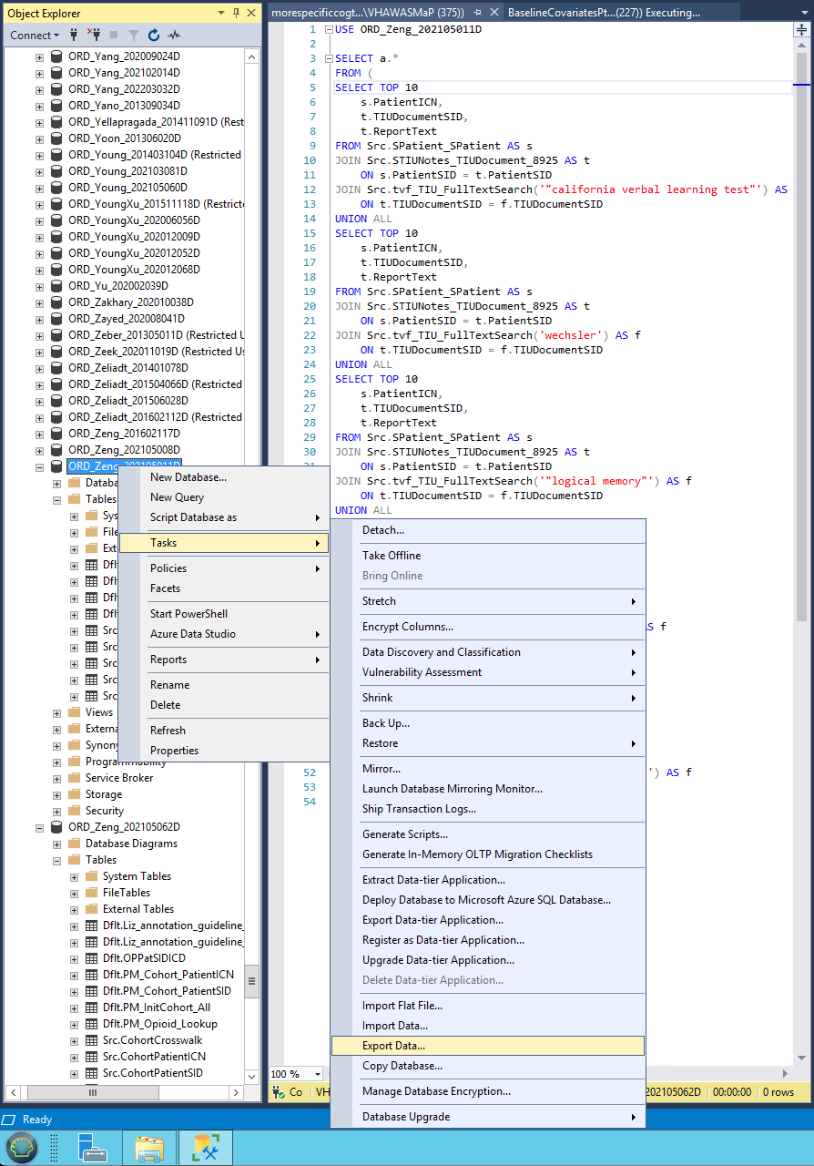
Right click on the Database: Task > Export Data

Slide 4
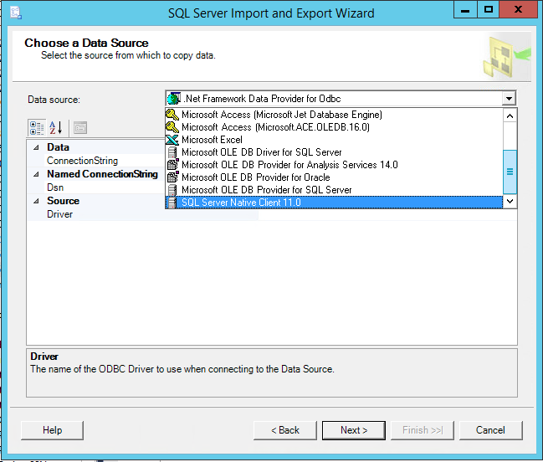
Select SQL Server as your Data Source, Click Next

Slide 5
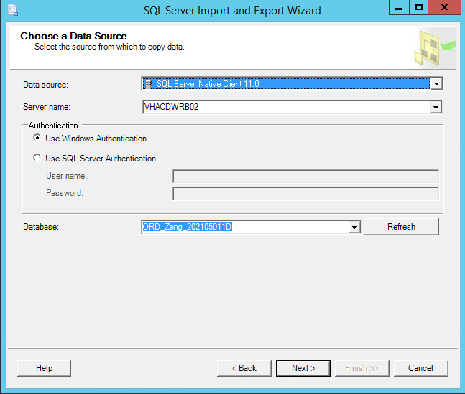
This should auto-fill. Use Windows Authentication, Click Next

Slide 6
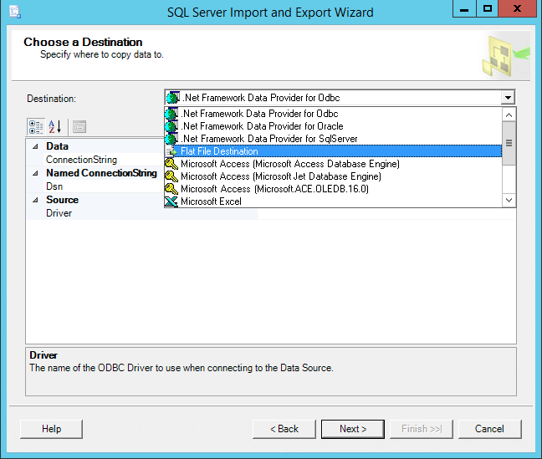
Select Flat File Destination as a Destination, Click Next.

Slide 7
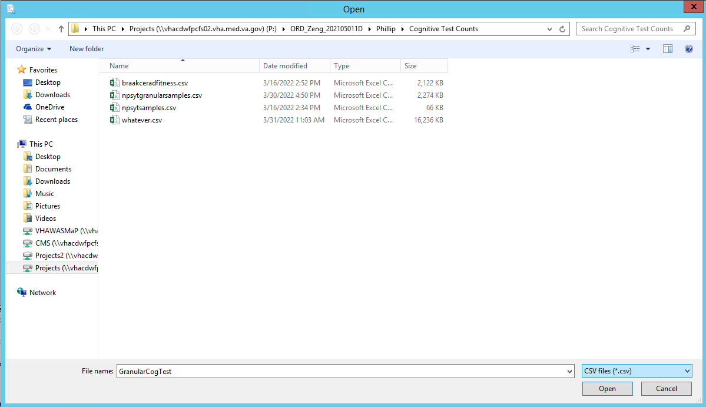
Select Browse to set the File Destination (otherwise it deposits the file on the Desktop). Make sure to select CSV as the output filetype.

Slide 8
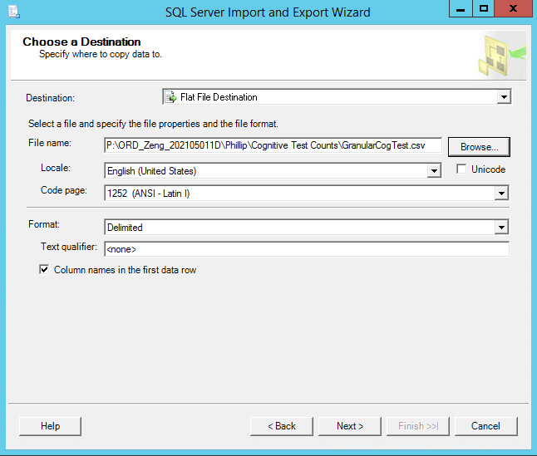
Here you can adjust settings on the CSV file such as encoding etc

Slide 9
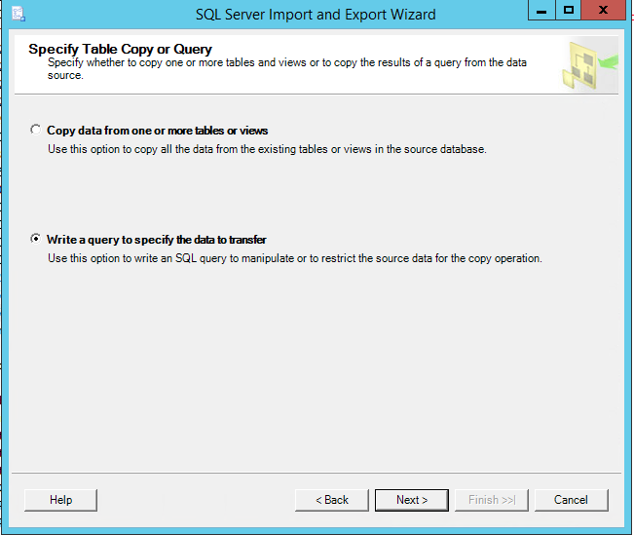
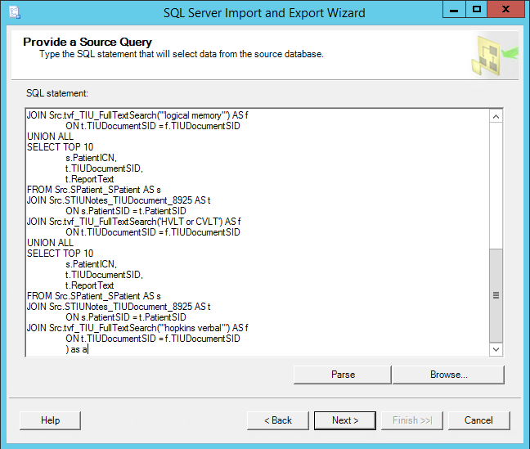
You can pull from an existing table or view, or put in your own query. It would probably be smart to pull from a view if you’ve already made one, otherwise providing your own source query would allow you to process these in batches (if you needed to make several csv files).

Slide 10
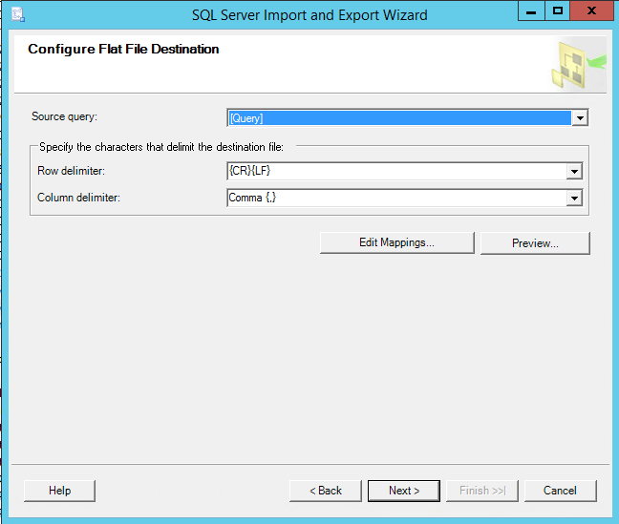
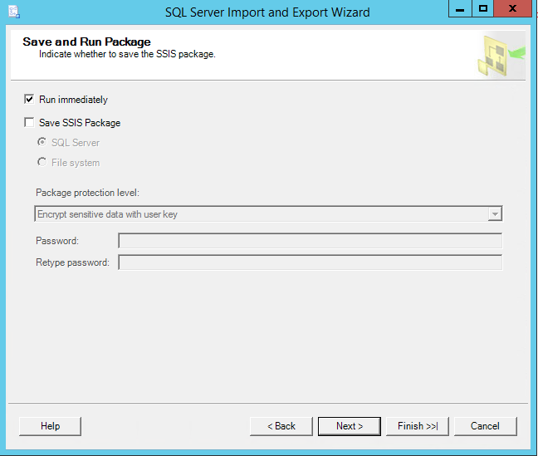
You can set custom delimiters on the left screen, Click Next, and then click Finish twice to run the Task

